Slide 1




CodiaC++
A mind blowing intro to Computer Science
By
Designed and presented by
Carin Samer

Slide 2

Introduction to Programming
Data Types
Today's Question Bank
Conditions
Loops
Designed and presented by
Carin Samer

Slide 3

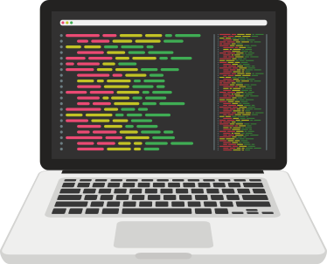
What comes in your mind when you hear about coding?
Designed and presented by
Carin Samer

Slide 4
At the end of the lesson, you'll be able to:
How the computer interprets data
How the computer deals with arrays and different data type
DID YOU KNOW?
Many programming languages are influenced by C++, some of which include C#, Java, and even newer versions of C.
How to use conditions
Understand how loops work
You’re going to learn a lot today!

Slide 5

Why are we learning a programming language? Is it only enough?

Slide 6


Visualization
Probably , it’s one of the most important skills one can acquire to learn anything , not just programming.
90% of the information transmitted to the brain is visual
50% of the brain is active in visual processing
50% of the brain is active in visual processing
Designed and presented by
Carin Samer

Slide 7
The Power of Search
Programmers use code search to answer questions about a wide range of topics, including what code does, where is code instantiated, why code is behaving a certain way, who was responsible for an edit and when it happened, and how to perform a task.
There are 5.9 million Google searches per minute
Research done by Google
Designed and presented by
Carin Samer

Slide 8
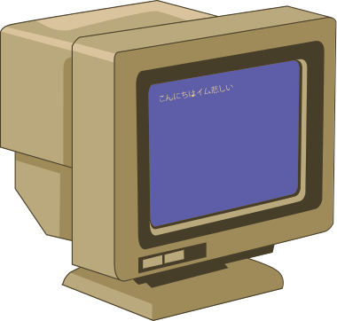
How Computer Understands Data?
ABC
أ ب ج
1234
/@&*
Designed and presented by
Carin Samer

Slide 9
How Computer Understands Data?
ABC
أ ب ج
1234
/@&*
ASCII Code

Slide 10
How Computer Understands Data?
ASCII Code Cheatsheet
A-Z
65-92
97-123
a-z
0-9
49-58

Slide 11
How Computer Understands Data?
Then. .
7
6
5
4
3
1
0
73
1001001
(2^6) + (2^4)+ (2^1) = 73
ASCII Code is interpreted into its binary representation

Slide 12



Feeling Great!
1
2
3
4
5
Temperature Check
Is everything clear till now? Send in chat
Lost

Slide 13



How does a computer classifies data?
3.14159265
Are they all the same?

Slide 14
Data Types
Numberical Values (integers)
int / long long
Characters (including numbers)
char
Fractions
float double
int x= 73;
char x=’c’;
float x=8.3;
Designed and presented by
Carin Samer

Slide 15
FINALLY!!!
The time has come to write your first program in C++!

Slide 16


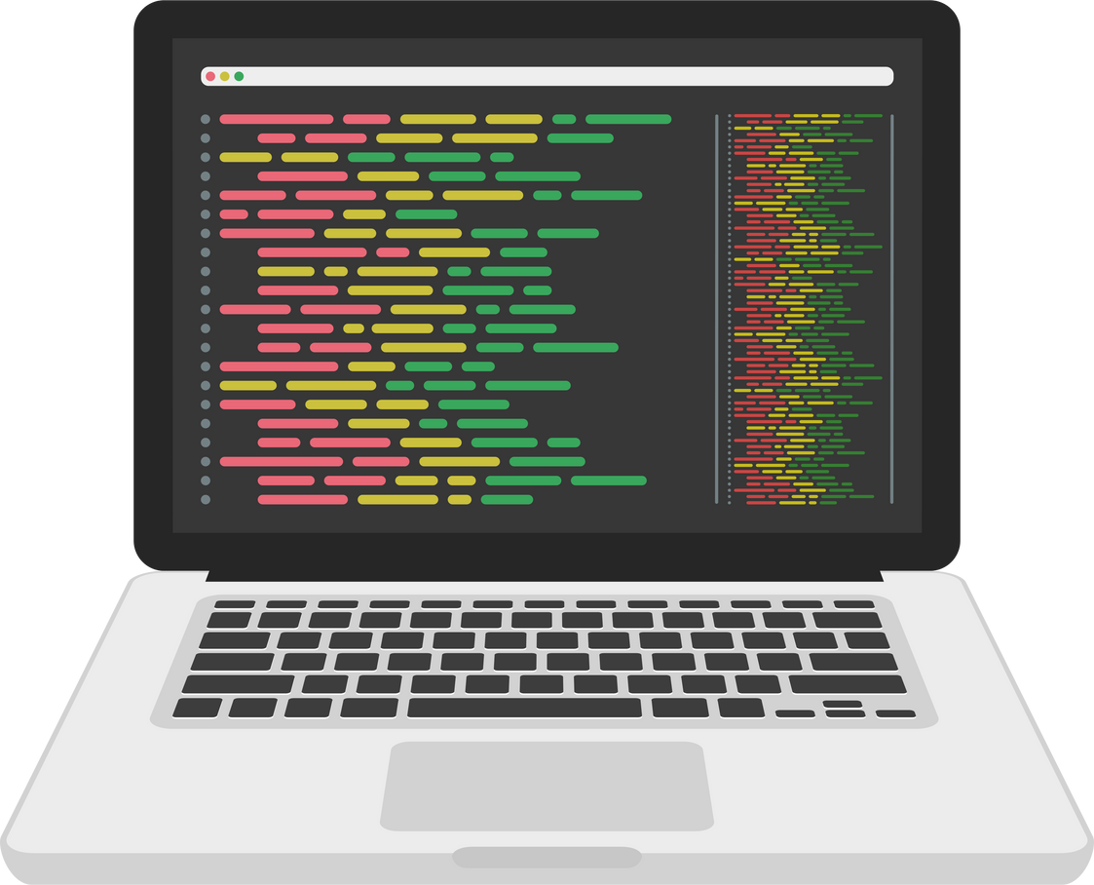
Try This!
Open the link sent in chat
Copy the template sent in chat
Define an integer, float and char
Search for how can we print them , and implement it
Designed and presented by
Carin Samer

Slide 17
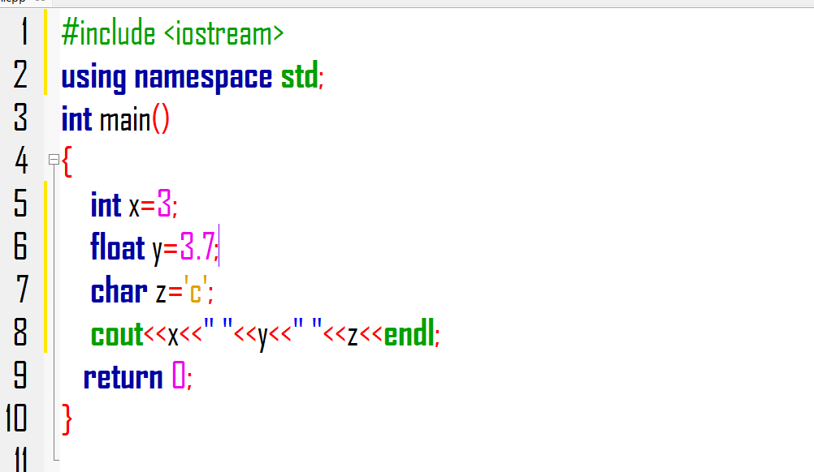
Exercise Answer

Slide 18
How does a computer executes given instructions?

Slide 19
if conditions
Unlike human brain, a computer is a systematic device that executes one task at a time and if the instructions to this task is incomplete, it stops working.
Algorithms aren’t exclusive to computers: We often associate them with computer science.

Slide 20
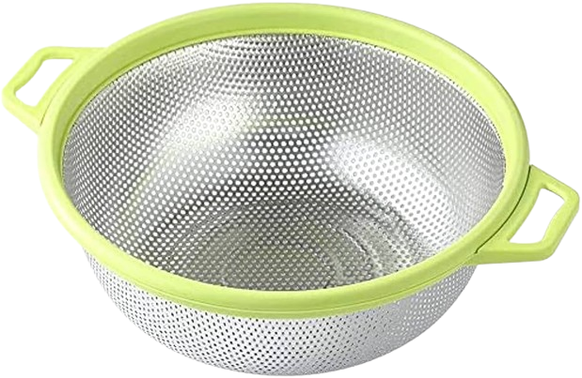
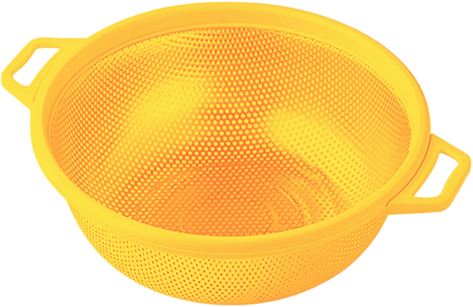
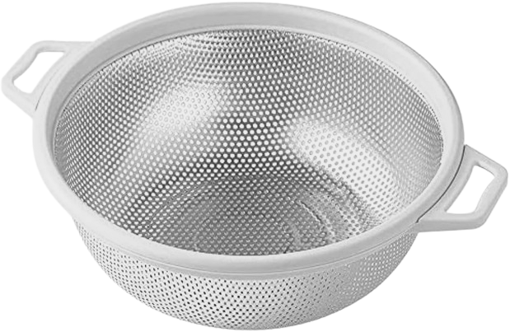
If and else if conditions
If conditions are like a sieve , that can decide which is going to pass or not.
We can use comparison operators && and || (and, or)
if we want to add another condition to the current one we use , (else if) or (else) at the end of the statement
If

Slide 21
Try This!
Complete the previous code
Write an if statement that states that if your integer is greater than 10 , it prints yes , other wise print no
Feel free to google it but , DO NOT COPY AND PASTE CODE!!

Slide 22
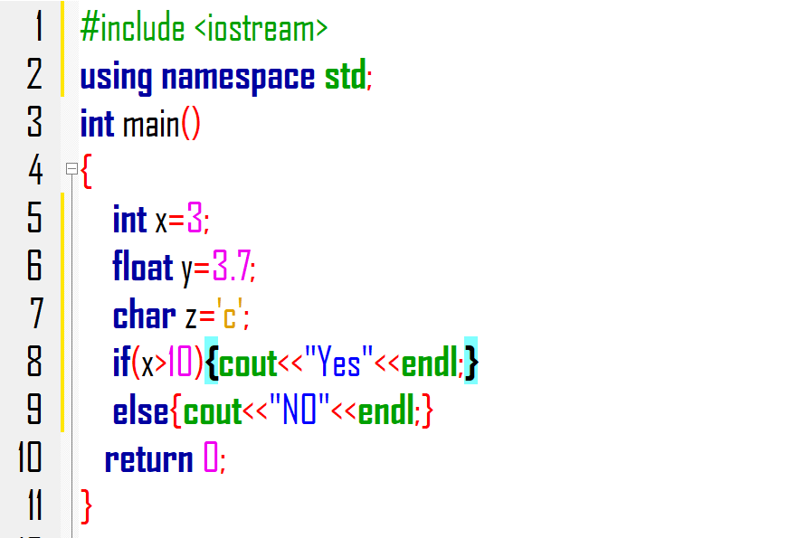
Exercise Answer

Slide 23
Feeling Great!
1
2
3
4
5
Temperature Check
Is everything clear till now? Send in chat
Lost

Slide 24
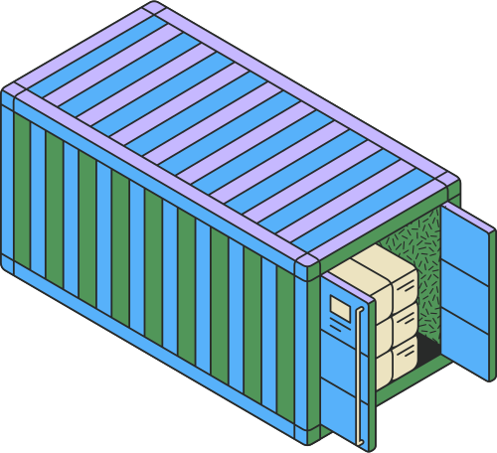
Back to data types, how can we store them in boxes or containers?
Designed and presented by
Carin Samer

Slide 25
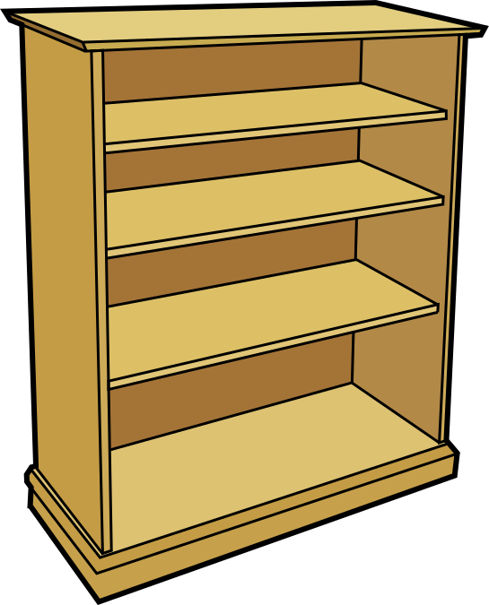
Arrays and strings
Data types can be stored in boxes inside the computer called Arrays
Sometimes we can store a value in a string (string is considered a data type while the array isn’t) and in this cases, it will be interpreted as a set of characters .

Slide 26
Arrays and strings
data type array name[size]={initial value}
int arr[100]={0};
double arr[100];
To access one element in the array arr[index]=x;

Slide 27


How to iterate through these containers?

Slide 28


Loops
Loops iterate through arrays starting from and to index you want.
That’s why it includes an if conditions that decide when it’s going to start and stop.
0
1
2
3
4
5
6
7
8
for (int i=0;i<=8;i++)
starting index
condition of iteration
how many steps are taken each time

Slide 29
Try This!
Complete the previous code
Create an array , and add element of your choice in it
Increment every element by 3 then print it.
Feel free to google it but , DO NOT COPY AND PASTE CODE!!

Slide 30
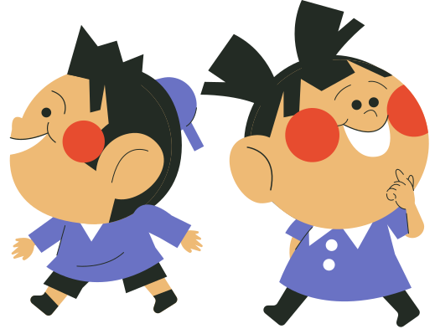
Can you name other types of loops and data types?
?
Name 2 additonal types of loops and how do they work
Designed and presented by
Carin Samer

Slide 31
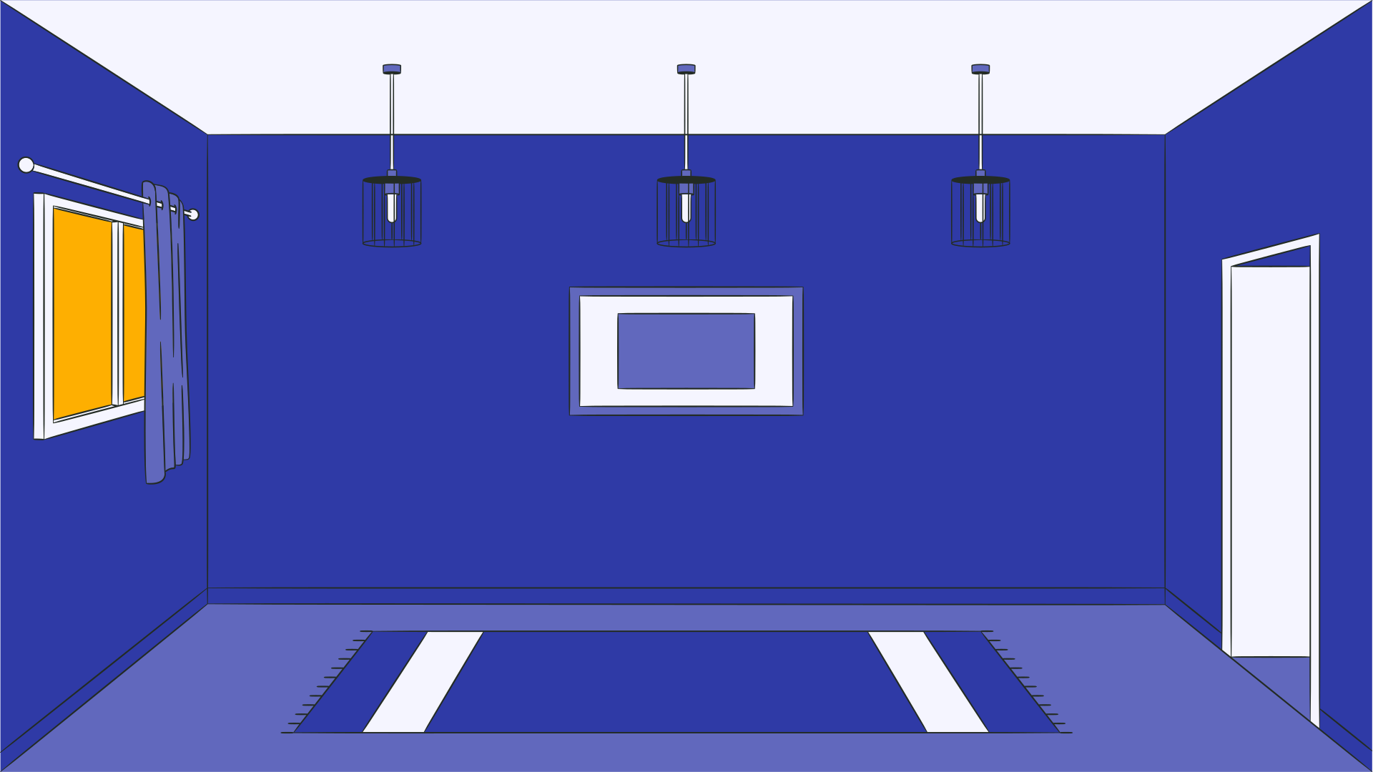




THAT’S IT!
Designed and presented by
Carin Samer

